Slide 1
Team 06
Siddiquie, Riffat Fatima Monzur, Rifat Moin, Hassan Bond, Charles Kavungum Padam, Mohammed Shafi
Limon, Alamgir Alam

Slide 2
Pre-Processing
Total data consists of 1million rows and 9 features.
Added Month and Year column for better understanding of data
Checked for Null Values in all three data set.
Merged both ‘Store’ and ‘Train’ data and ‘Store’ and ‘Test’ data
Converted the State Holiday column from object to int for better processing of data.
Added few other columns for better understanding of data
We replaced with nan values with Median (instead of mean due to outliers) .

Slide 3
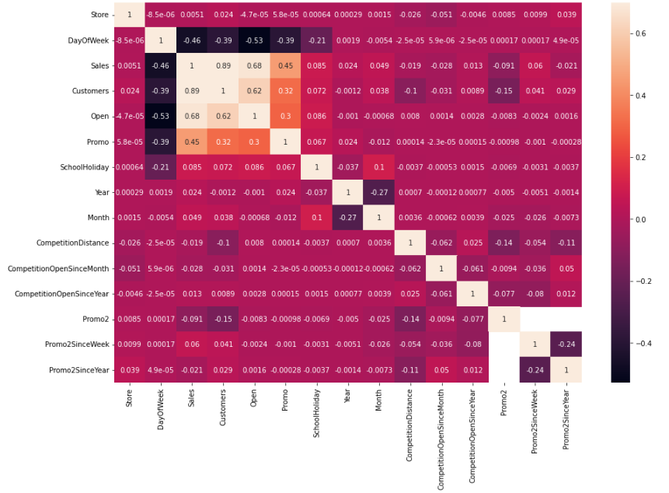
As you can see below there’s a very low correlation between ‘Promo2SinceWeek’, ‘CompetitionOpenSinceYear’, ‘CompetitionOpenSinceMonth’, ’CompetitionDistance’. So, we dropped all these columns.

Slide 4
Label Encoded ‘StateHoliday’ , ‘StoreType’ & ‘Assortment’ columns. We converted it to numerical values which is more machine readable
Checked correlation of features with sales.
Checked promo and competition throughout the year and added them to new columns.
Checked the datatype of all the columns so that model will processing smoothly.

Slide 5
Feature Selection of Train and Test Data
Analysed both merged train-store data and test-store data.
Analysed and dropped the columns that are not necessary from both train-store data and test-store data.
This was done by checking the correlation of model.
Converted the Open column to float type.
Analysed train-store data and test-store data after dropping to check the null values.
Open column contained null values was replaced with 1 as analysis showed that store was not falling under any Holidays nor Sundays.

Slide 6
Long Short-Term Memory(LSTM)
What is LSTM? LSTM is a type of RNN Deep Neural Network with higher memory power to remember the outputs of each node for a more extended period to produce the outcome for the next node efficiently.
Why did we use LSTM ? - One of the most advanced models out there to forecast time series is the LSTM Neural Network - LSTM assists RNN in remembering the critical inputs needed to generate the correct output. - LSTM tackles gradient vanishing by ignoring useless data in the network.
We split data 80:20 for training and testing with random_state=42.
We used Keras & Tensorflow to train models

Slide 7
Architecture 1
Bidirectional Model
model = Sequential()
model.add(Bidirectional(LSTM(22, return_sequences=True), input_shape=(X_train.shape[1],1)))
model.add(Dropout(0.2))
model.add(Bidirectional(LSTM(22, return_sequences=True)))
model.add(Dropout(0.2))
model.add(Bidirectional(LSTM(22, return_sequences=True)))
model.add(Dropout(0.2))
model.add(Bidirectional(LSTM(22)))
model.add(Dropout(0.2))
model.add(Dense(1))

Slide 8
Architecture 2
LSTM Model
model = Sequential()
model.add(LSTM(25, return_sequences=True,
input_shape=(X_train.shape[1], 1)))
model.add(LSTM(25, return_sequences=False))
model.add(Dense(10))
model.add(Dense(1))
model.summary()

Slide 9
Architecture 3
LSTM along with Batch Normalization
model = Sequential()
model.add(LSTM(64, activation='relu', input_shape=(X_train.shape[1], X_train.shape[2]), return_sequences=True))
model.add(BatchNormalization())
model.add(Dense(1))
model.summary()

Slide 10
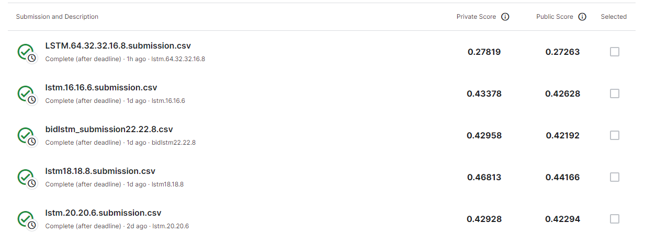
Kaggle Score
Best Score 0.27

Slide 11
Contribution
Siddiquie, Riffat Fatima – Model & Architecture
Monzur, Rifat – Data Analysis, Pre-processing
Moin, Hassan – Model & Architecture
Bond, Charles - Feature Selection
Kavungum Padam, Mohammed Shafi –Model Evaluation and Optimization
Limon, Alamgir Alam – Data Analysis, Pre-Processing

Slide 12
Thank You

